Slide 1

Lagomorph Species Observation and Survey Database
{ GRSA Project }
Introduction:
This project focuses on analyzing ecological survey data of lagomorph species (rabbits and hares) collected from the Great Sand Dunes National Park and Preserve (GRSA). Using PostgreSQL, the data was cleaned, organized, and explored to uncover meaningful insights about species distribution, habitat preferences, and environmental conditions. The project demonstrates how data-driven analysis can support wildlife management, biodiversity assessment, and scientific research using structured SQL queries.
{ Data & Methodology }

Slide 2
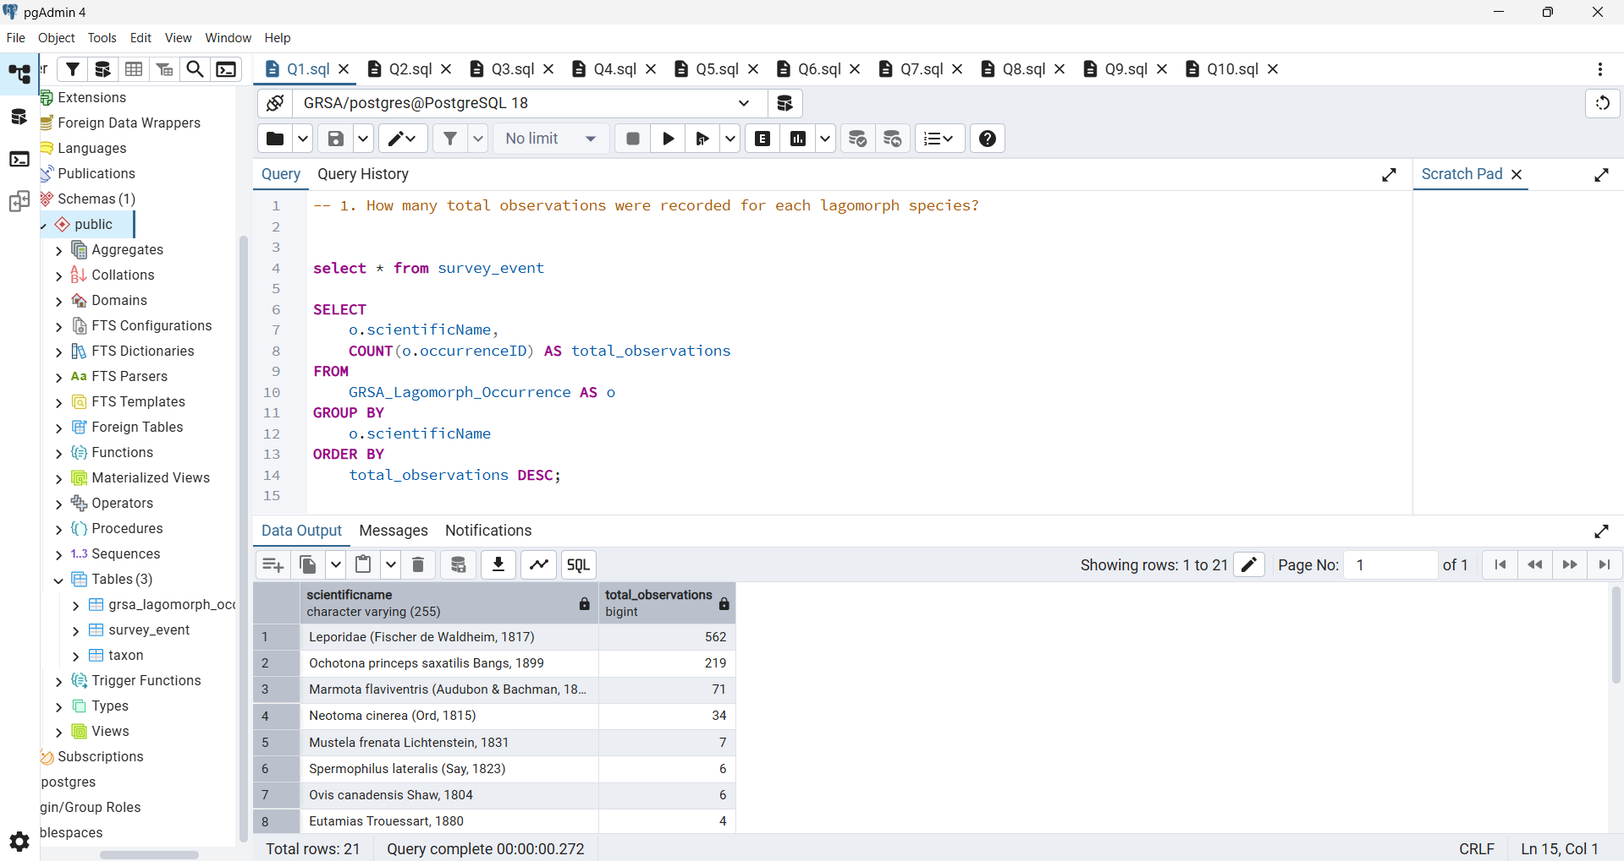
Question 1
How many total observations were recorded for each lagomorph species?
Answer:-
This query identifies which habitat type recorded the highest number of lagomorph occurrences. It groups all records by habitat type, counts total observations, and helps determine which environment supports the greatest lagomorph activity
Concepts:-
GROUP BY
COUNT()
JOIN

Slide 3
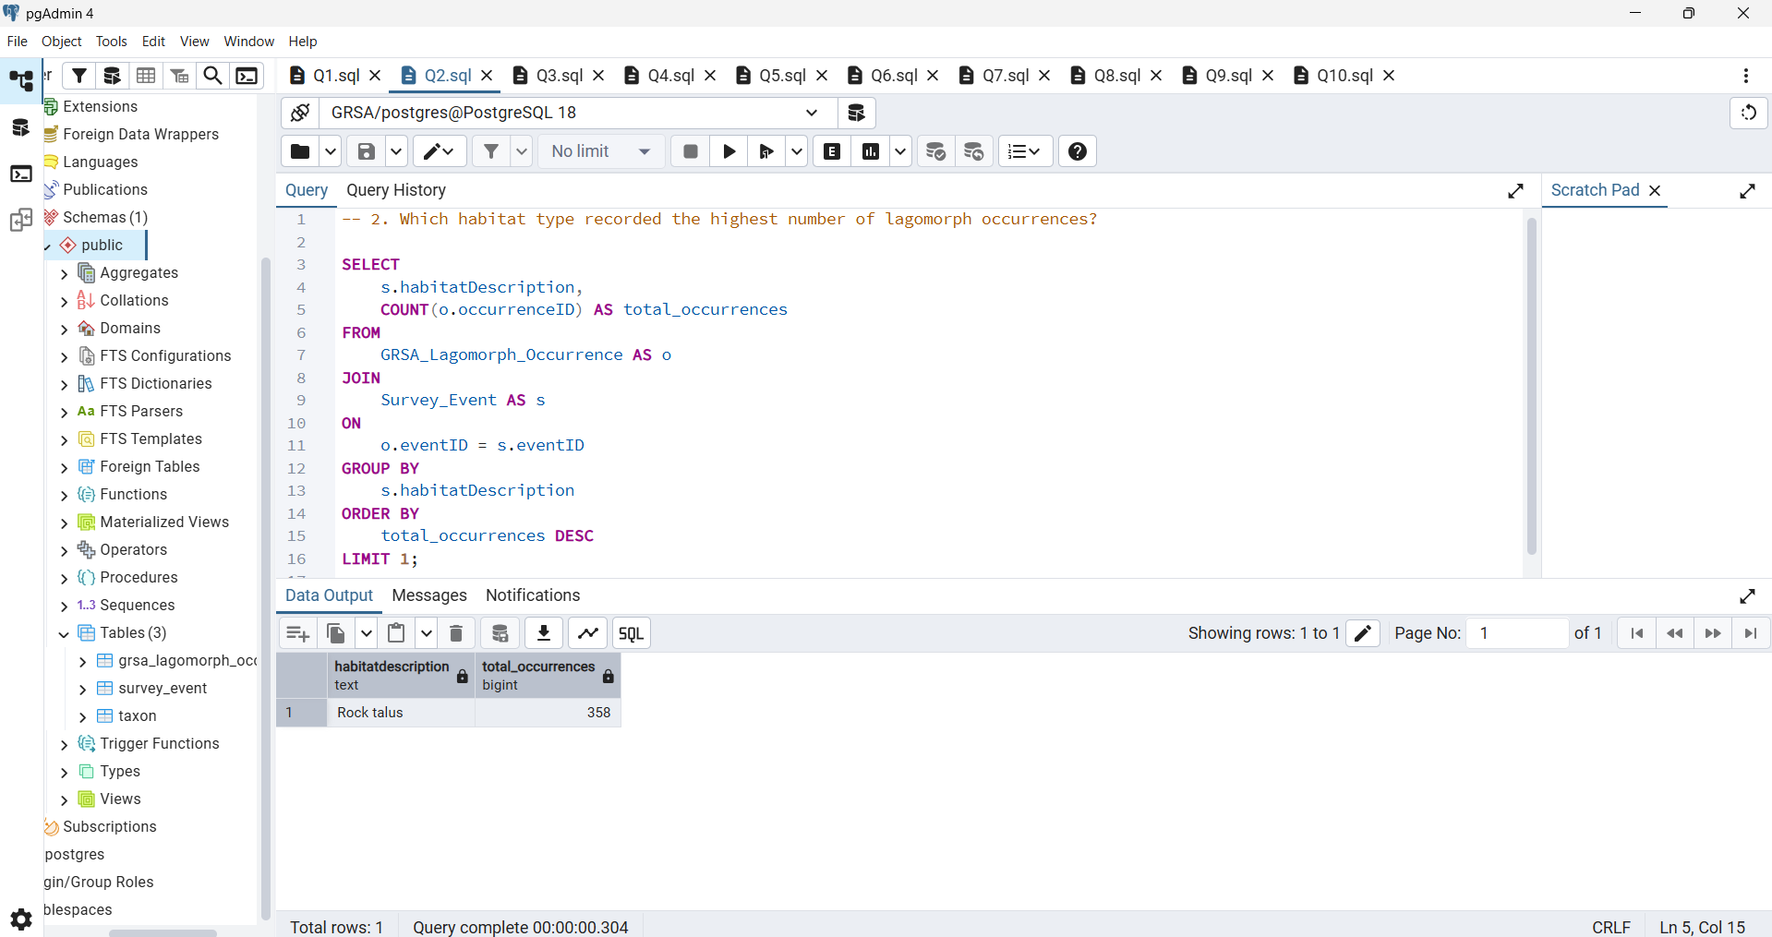
Question 2
Which habitat type recorded the highest number of lagomorph occurrences?
Answer:-
This query calculates the average temperature at which each species was observed. By joining occurrence data with survey event details it reveals the temperature range each species prefers, offering insight into ecological adaptation.
Concepts:-
JOIN
GROUP BY
ORDER BY DESC
LIMIT

Slide 4
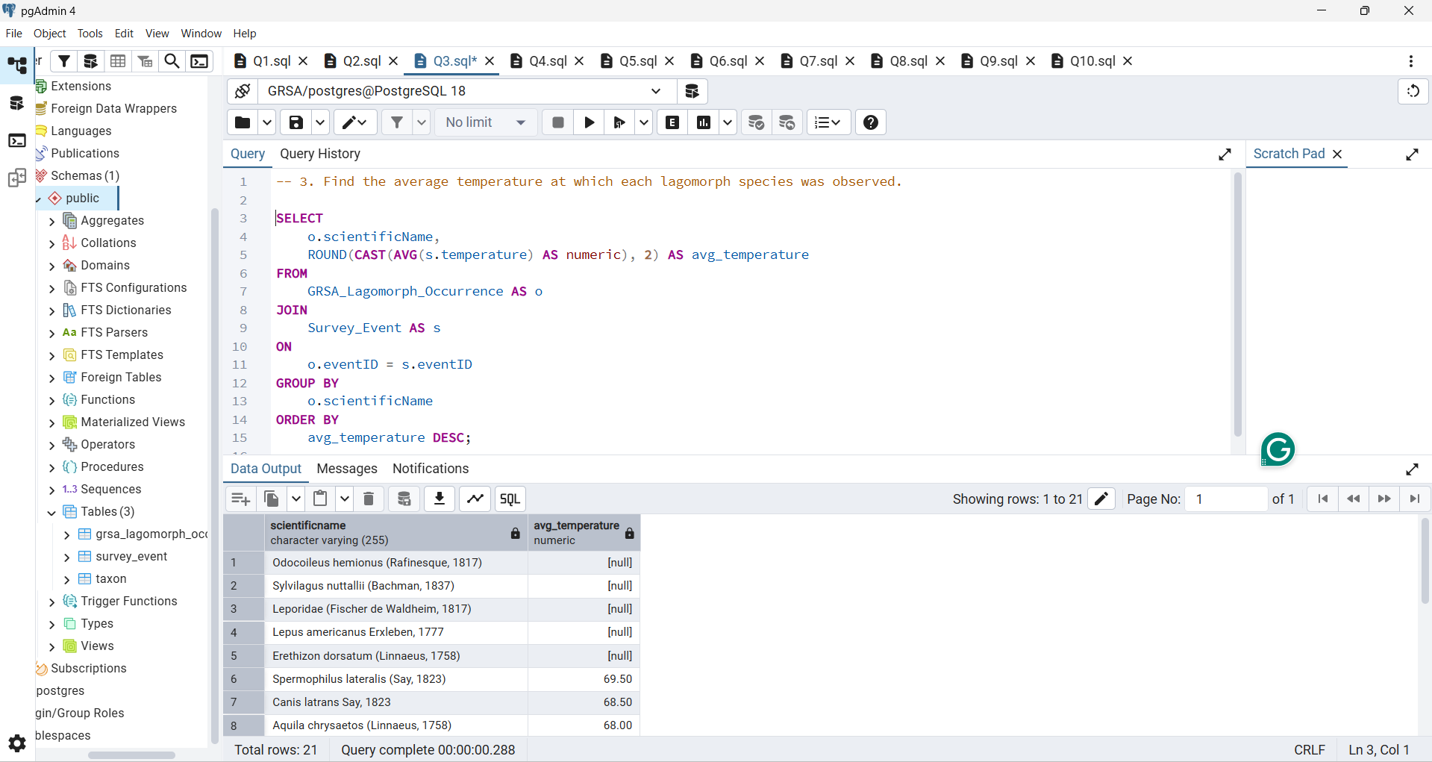
Question 3
Find the average temperature at which each species was observed.
Answer:-
This query finds which species has the highest total count across all events. It aggregates the individual counts per species to highlight the most dominant or frequently seen species in the entire dataset.
Concepts:-
JOIN
GROUP BY
Average ()

Slide 5
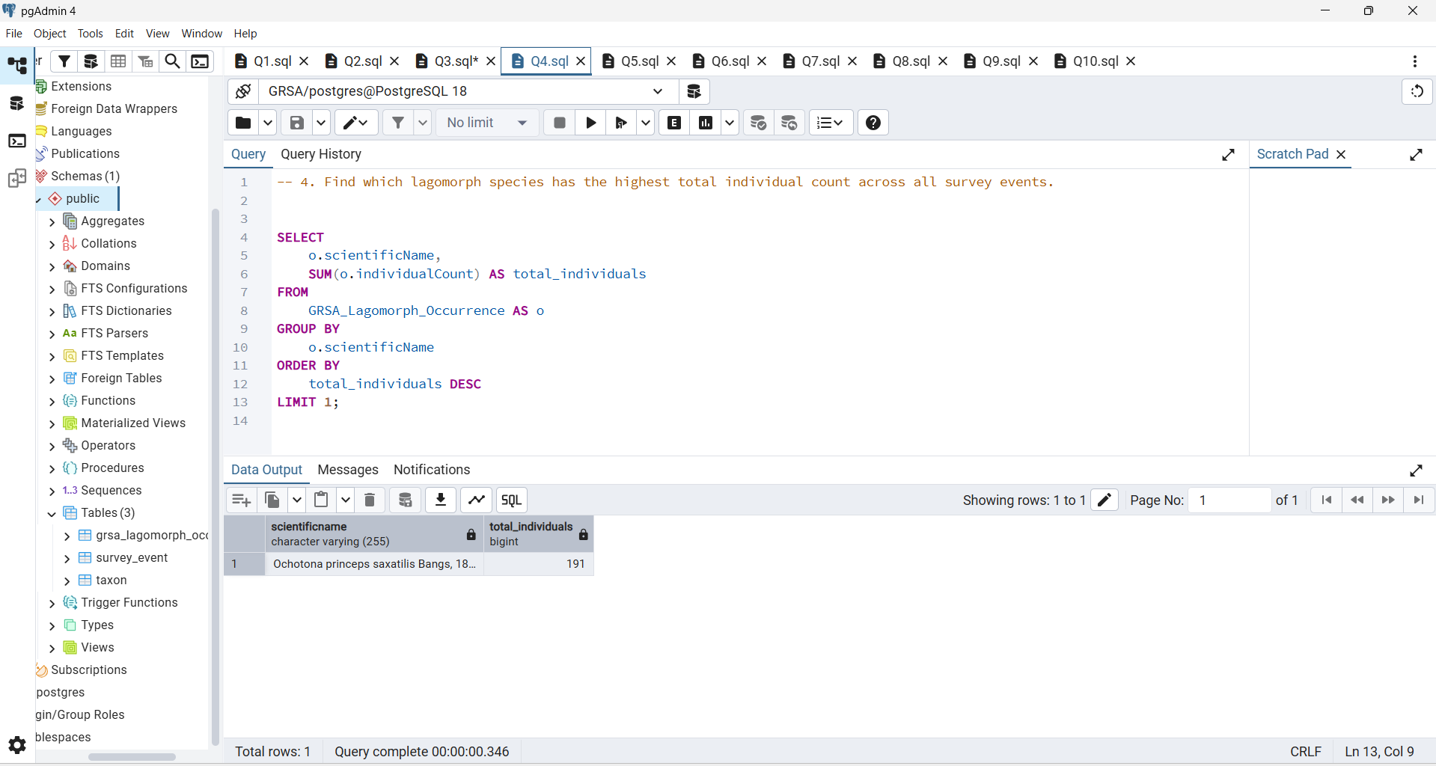
Question 4
Which species has the highest total count (individual Count) across all events?
Answer:-
This query determines which survey event recorded the highest total number of individuals. It sums up all individual counts per event, helping researchers identify when and where the largest concentrations of lagomorphs were observed.
Concepts:-
SUM ()
GROUP BY
ORDER BY

Slide 6
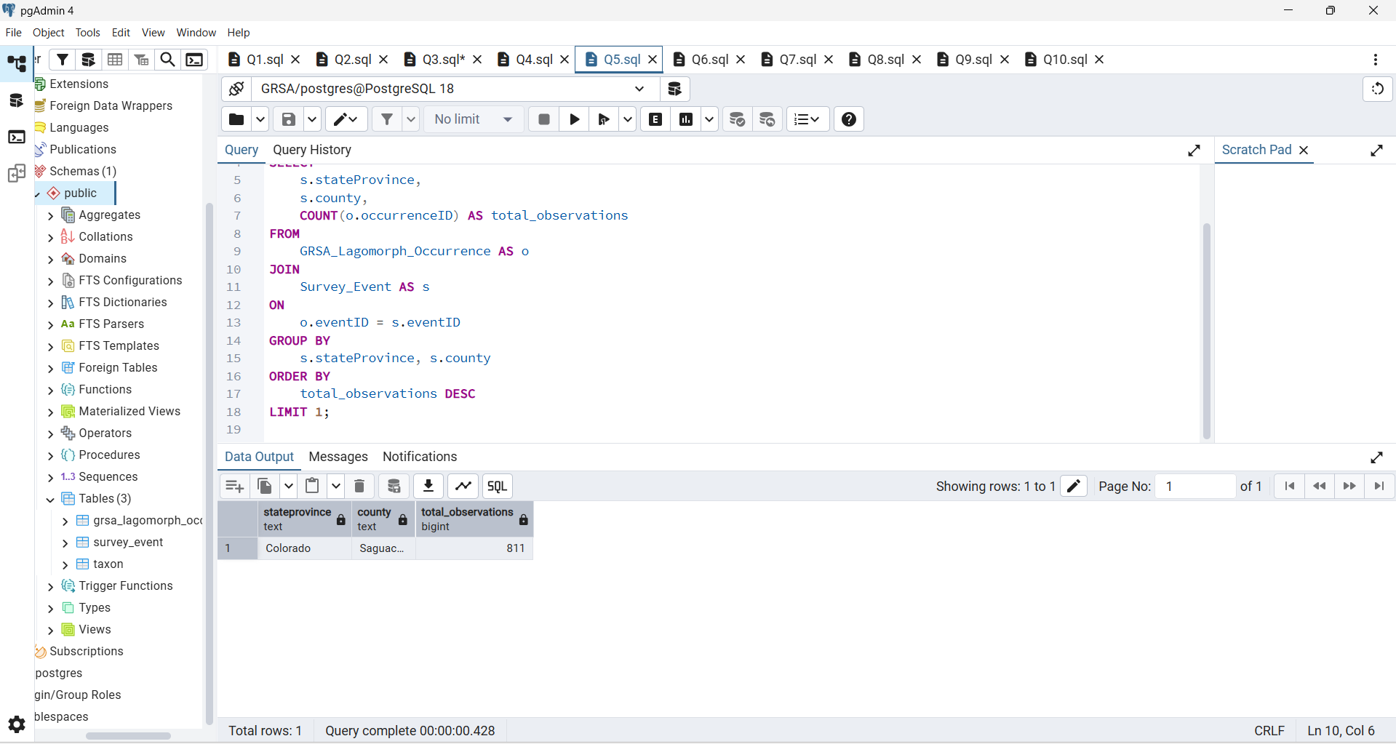
Question 5
Which county or state had the greatest number of lagomorph sightings?
Answer:-
This query filters survey events that occurred during rainfall conditions. It focuses on weather-based observations, allowing analysis of animal presence and behaviour during rainy environments.
Concepts:-
JOIN
GROUP BY
COUNT ()

Slide 7
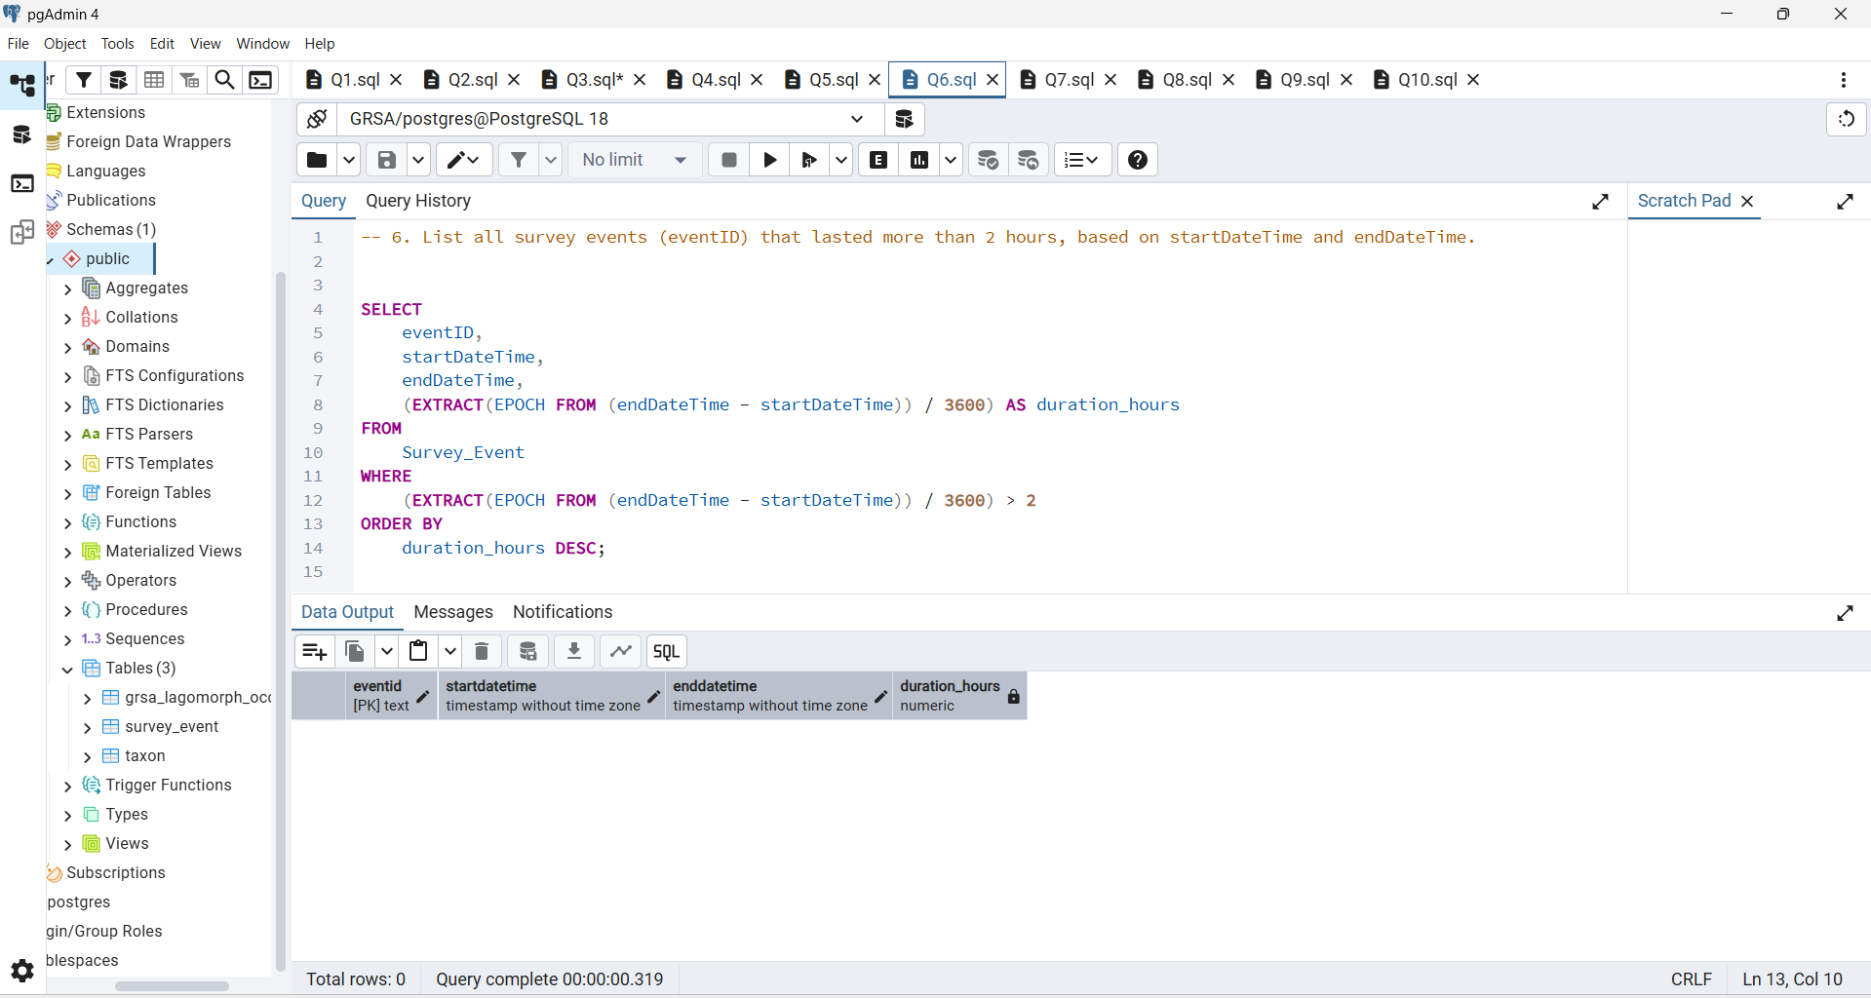
Question 6
List surveys (event ID) that lasted more than 2 hours between start Date Time and end Date Time.
Answer:-
This query shows the total number of occurrences recorded by each observer. It measures the data collection contribution of individual researchers or volunteers, helping assess participation levels.
Concepts:-
AGE()
EXTRACT(EPOCH FROM ...)
WHERE

Slide 8

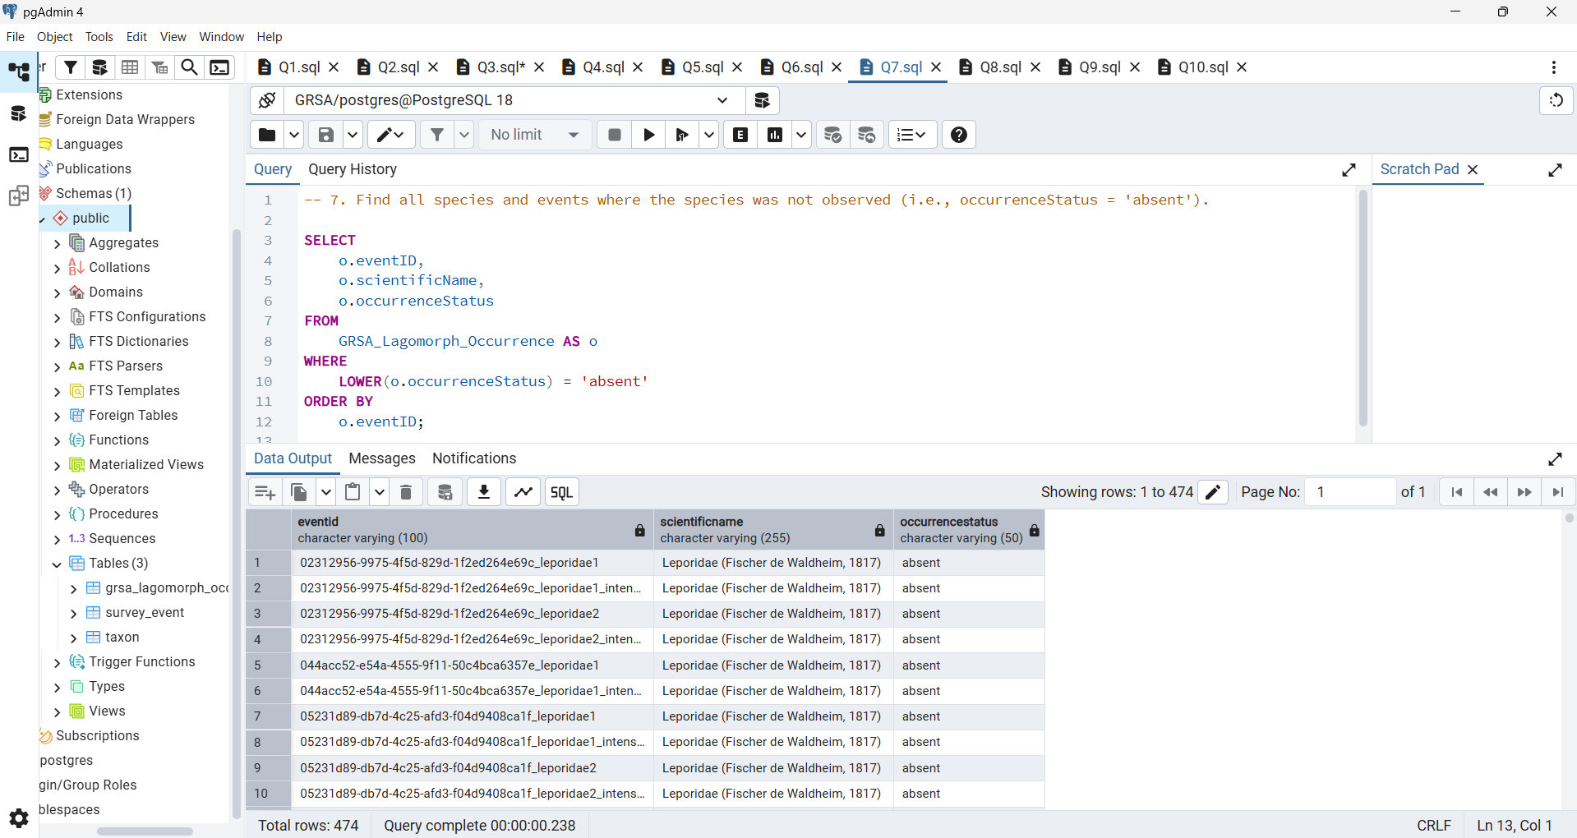
Question 7
Find all species and events where occurrence status = 'absent'.
Answer:-
This query identifies which months had the highest number of lagomorph observations. By extracting and grouping data by month it reveals seasonal activity or migration patterns in the dataset.
Concepts:-
Simple SELECT and filter

Slide 9
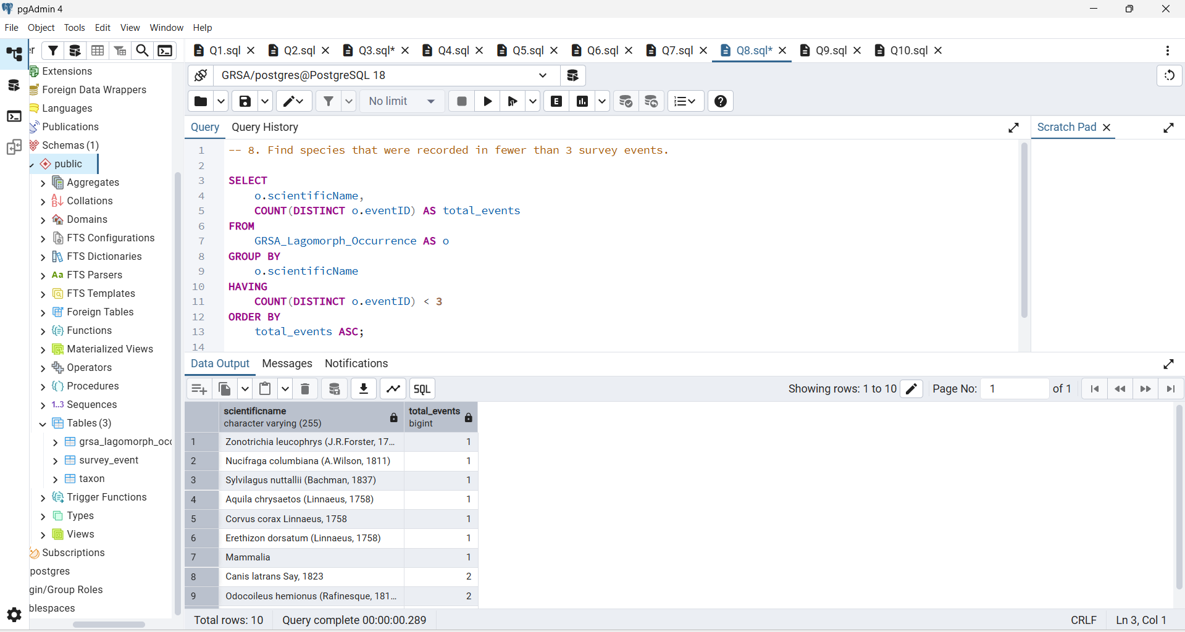
Question 8
Which species were recorded in fewer than 3 survey events?
Answer:-
This query finds the top three species most frequently recorded. It counts how many times each species appeared in different events, ranking them by frequency to show which species are most common.
Concepts:-
COUNT(DISTINCT eventide)
HAVING

Slide 10
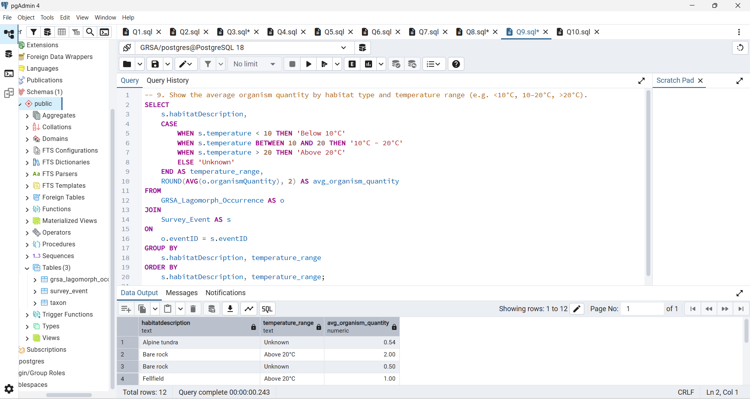
Question 9
Show the average organism quantity by habitat, Description and temperature range (e.g. <10°C, 10–20°C, >20°C).
Answer:-
This query examines how average organism quantity varies across habitat types and temperature ranges. It categorises temperatures into bands and averages population counts, uncovering environmental influences on species abundance.
Concepts:-
CASE WHEN
AVG()
GROUP BY

Slide 11
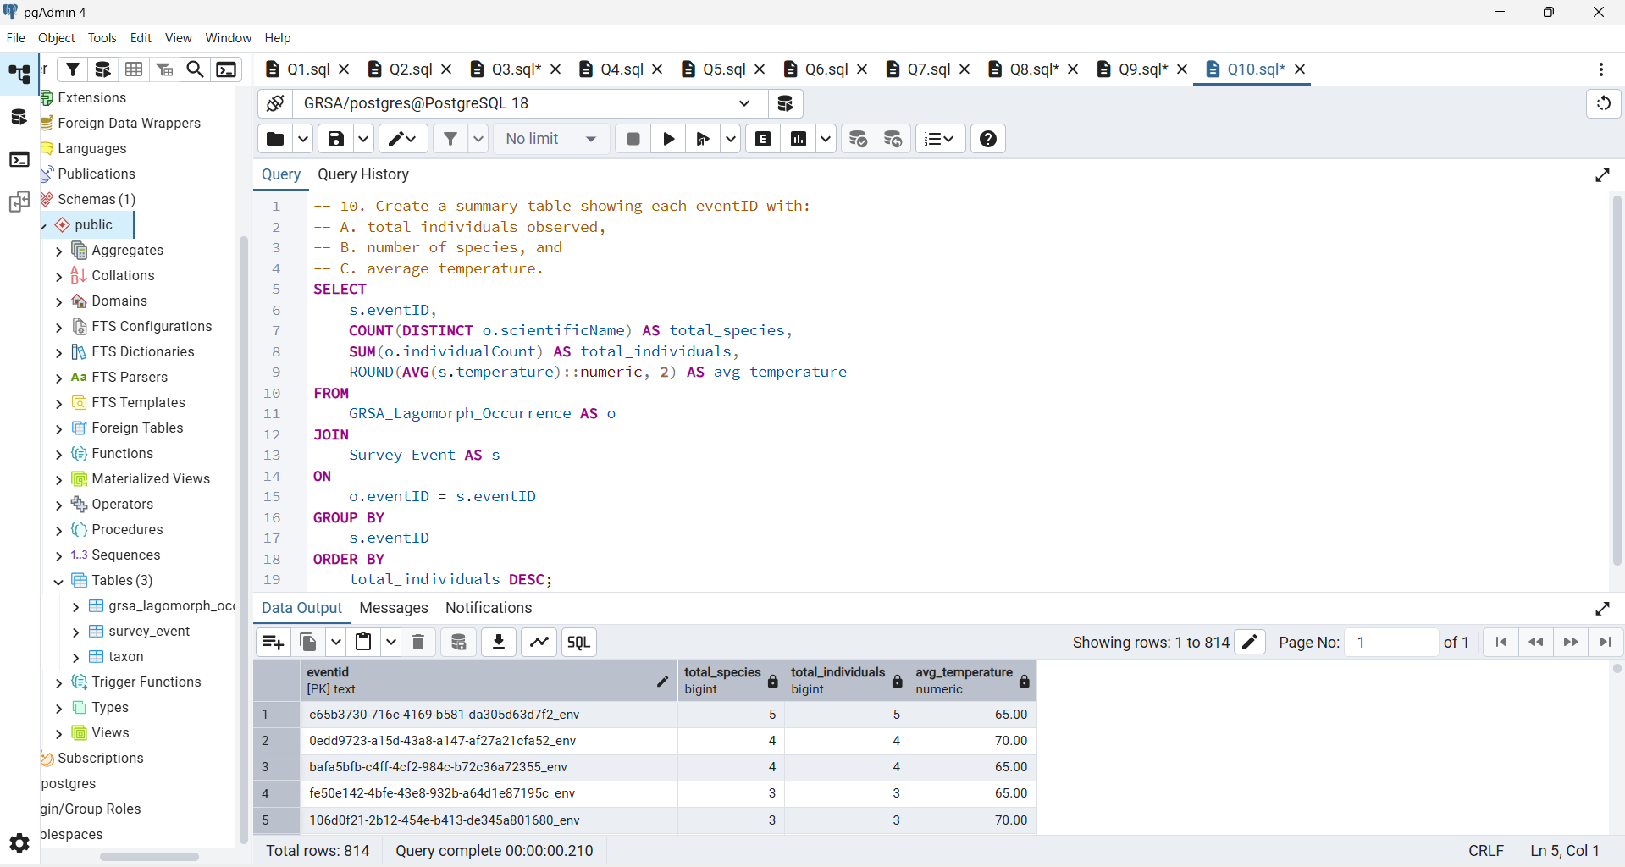
Question 10
Create a summary table showing each eventID with:
Total individuals observed,
Number of species,
Average temperature.
Answer:-
This query creates an event summary showing the total species, total individuals, and average temperature per event. It combines biodiversity and environmental metrics into one compact overview to evaluate survey outcomes.
Concepts:-
Aggregations + JOIN across all three tables

